Slide 1
Chapter 11
Dictionaries

Slide 2
List of contents
Operations on Dictionaries
Dictionary methods
Using for loop with dictionaries
Sorting the elements of a dictionary using lambdas
Converting lists into dictionary
Converting strings into dictionary
Passing dictionaries to functions
Ordered dictionaries

Slide 3
Introduction
A dictionary represents a group of elements arranged in the form of key-value pairs.
In the dictionary, the first element is considered as 'key' and the immediate next element is taken as its 'value'.
The key and its value are separated by a colon “ : ”
All the key-value pairs in a dictionary are inserted in curly braces { }
To use this kind of structure, python provides dict built in class
For example
>>> dict = {'Name': 'Chandra', 'Id': 200, 'Salary': 9080.50}

Slide 4
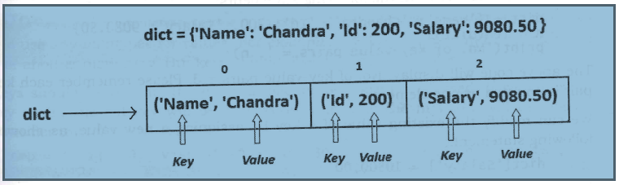
Go to Jupyter notebook for example

Slide 5
Operations on Dictionaries
To access the elements of a dictionary, we should not use indexing or slicing. For example, dict[0] or dict[1:3] etc. expressions will give error.
To access the value associated with a key, we can mention the key name inside the square braces, as: dict['Name']. This will return the value associated with 'Name'. This is nothing but 'Chandra'.
If we want to know how many key-value pairs are there in a dictionary, we can use the len() function, as shown in the following statements:
dict = {'Name': 'Chandra', 'Id': 200, 'Salary': 9080.50}
n = len(dict)
print('No. of key-value pairs =‘, n)
The above code will display:
No. of key-value pairs = 3.
Please remember each key-value pair is counted as one element.

Slide 6
We can modify the existing value of a key by assigning a new value, as shown in the following statement:
dict['Salary'] = 10500.00
Here, the 'Salary' value is modified as '10500.00'. The previous value of 'Salary', i.e. 9080.50 is replaced by the new value, i.e. 10500.00.
We can also insert a new key-value pair into an existing dictionary. This is done by mentioning the key and assigning a value to it, as shown in the following statement:
dict[‘Dept'] = 'Finance’
Now, if we display the dictionary using print(dict), it will display:
{'Name': 'Chandra', 'Dept': 'Finance', 'Id': 200, 'salary': 10500.0}
Observe the new pair 'Dept': 'Finance' is added to the dictionary.
Also, observe that this pair is not added at the end of existing pairs. It may be added at any place in the dictionary. This is because the elements in dictionary and set are stored not in an order

Slide 7
Suppose, we want to delete a key-value pair from the dictionary, we can use del statement as:
del dict['Id']
This will delete the key 'Id' and its corresponding value from the dictionary. Now, the dictionary looks like this:
{'Name': 'Chandra', 'Dept': 'Finance', 'Salary': 10500.0}
To test whether a 'key' is available in a dictionary or not, we can use 'in' and 'not in' operators. These operators return either True or False. Consider the following statement:
'Dept' in dict # check if 'Dept is a key in dict
The preceding statement will give:
True
Now, if you write:
'Gender' not in dict # check if 'Gender' is not a key in dict
Then the following output appears:
True

Slide 8
We can use any datatypes for values.
For example, a value can be a number, string, list, tuple or another dictionary. But keys should obey the following rules:
Keys should be unique. It means, duplicate keys are not allowed. If we enter same key again, the old key will be overwritten and only the new key will be available
Consider the following example:
>>> emp = {'Nag':10, 'vishnu':20, 'Nag':30} # Key 'Nag' entered twice
>>> print(emp)
The output appears as:
>>> {'Nag': 30, 'Vishnu': 20} # first 'Nag' is replaced by new key and its value
Keys should be immutable type. For example, we can use a number, string or tuples as keys since they are immutable. We cannot use lists or dictionaries as keys. If they are used as keys, we will get `TypeError'.
Consider the following example:
>>> emp = { [‘Nag’]:10, 'Vishnu':20, 'Raj':30} # ['Nag'] is a list element
- so error
Traceback (most recent call last):
File "<pyshell#12>", line 1, in <module>
emp = {['Nag']:10, 'vishnu':20, 'Raj':30}
TypeError: unhashable type: 'list'

Slide 9
Dictionary methods
Method | Example | Description
clear() | d.clear() | Removes all key-value pairs from dictionary 'd'.
copy() | d1= d.copy() | Copies all elements from 'd' into a new dictionary 'd1'.
fromkeys() | d.fromkeys(s [,v]) | Create a new dictionary with keys from sequence 's' and values all set to 'v'.
get() | d.get(k [,v]) | Returns the value associated with key 'k'. If key is not found, it returns 'v'.
items() | d.items() | Returns an object that contains key-value pairs of 'd'. The pairs are stored as tuples in the object.
keys() | d.keys() | Returns a sequence of keys from the dictionary 'd'.
values() | d.values() | Returns a sequence of values from the dictionary 'd'.
update() | d.update(x) | Adds all elements from dictionary 'x' to 'd'.
pop() | d.pop(k [ ,v]) | Removes the key ‘k’ and its value from 'd' and returns the value. If key is not found, then the value ‘v' is returned. If key is not found and 'v' is not mentioned then 'KeyError' is raised.
setdefault() | d.setdefault(k [,v]) | If key ‘k' is found, its value is returned. If key is not found, then the k, v pair is stored into the dictionary ‘d’

Slide 10
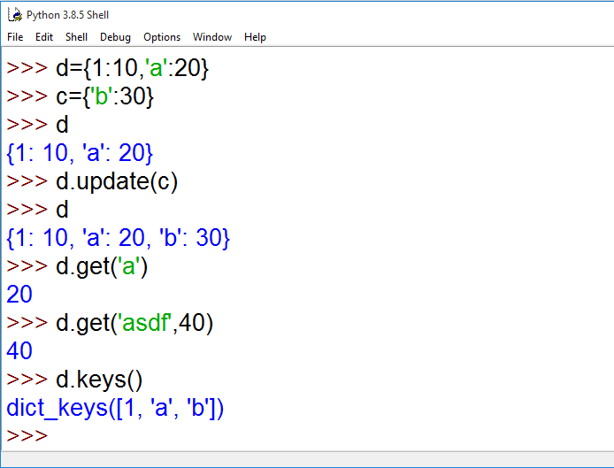
Go to Jupyter notebook for more examples

Slide 11
Using for loop with dictionaries
For loop is very convenient to retrieve the elements of a dictionary
Example program to Find the Occurrences of Each Letter of a String using a Dictionary
Go to Jupyter notebook for examples
x | Found in dict | dict.get(x, 0) + 1 | dict[x] = dict.get(x, 0) + 1 | dict
B | No | 1 | dict[‘B’] = 1 | {‘B’:1}
o | No | 1 | dict[‘o’] = 1 | {`B':1, 'o':1}
o | Yes | 2 | dict[‘o’] = 2 | {‘B':1, 'o':2)
k | No | 1 | dict[‘k’] = 1 | {‘B':1, 'o':2, 'k':1}

Slide 12
Sorting the elements of a dictionary using lambdas
A lambda is a function that does not have a name.
Lambda functions are written using a single statement and hence look like expressions.
Lambda functions are written without using ‘def’ keyword. They are useful to perform some calculations or processing easily.
For example,
f = lambda x, y: x+y
The above expression is a lambda function with 2 arguments, x and y. After colon (:), we wrote the body, i.e. x+y. this is the value returned by the lambda function. At the time of calling this function, we are supposed to pass 2 values for x and y as: f(10, 15). This will return 25 as result.
Let us see Python program to sort the elements of a dictionary based on a key or value using lambda
Go to Jupyter notebook for examples

Slide 13
Converting lists into dictionary
When we have two lists, it is possible to convert them into a dictionary
The zip() function is useful to convert the sequences into a zip class object. There may be 1 or more sequences that can be passed to zip() function.
The second step is to convert the zip object into a dictionary by using dict() function.
Go to Jupyter notebook for examples

Slide 14
Converting strings into dictionary
When a string is given with key and value pairs separated by some delimiter (or separator) like a comma ( , ) we can convert the string into a dictionary
Let us take an example string
str=“Vijay=23 , Ganesh=20, Lakshmi=19, Nikhil=22”
First we should split the string into pieces where a comma is found using split( ‘,’ ) method and then brake the string at equals ( = ) symbol. This can be done using a for loop as:
for x in str.split(‘,’):
y=x.split(‘=‘)
Each piece of the string is available in 'y'. The second step is to store these pieces into a list `1st' using append() method as:
1st . append(y)
The third step is to convert the list into a dictionary 'd' using diet() function as:
d = dict(lst)
Now, this dictionary 'd' contains the elements as:
{'Vijay': '23', 'Ganesh': '20', 'Lakshmi': '19', 'Nikhil': '22'}
Go to Jupyter notebook for examples

Slide 15

Passing dictionaries to functions
We can pass a dictionary to a function by passing the name of the dictionary
Go to Jupyter notebook for examples
Ordered dictionaries
We already discussed that the elements of a dictionary are not ordered. It means the elements are not stored into the same order as they were entered into the dictionary. Sometimes this becomes a problem.
An ordered dictionary is a dictionary but it will keep the order of the elements. The elements are stored and maintained in the same order as they were entered into the ordered dictionary.

Slide 16
We can create an ordered dictionary using the OrderedDict() method of `collections' module. So, first we should import this method from collections module, as:
from collections import OrderedDict
Once this is done, we can create an ordered dictionary with the name 'd' as:
d = OrderedDict()
We can store the key and values into 'd', as:
d[10] = 'A'
d[11] = 'B'
d[12] = 'C'
d[13] = ‘D’
Here, 10 is the key and 'A' is its value and so on. This order is not disturbed because ‘d’ is an ordered dictionary. When we display the key - value pairs from the dictionary 'd', we can see the same order.
Go to Jupyter notebook for examples

